Slide 1
Longest Path

Slide 2
Longest path problem
Given a graph G and nodes s and t, What is the shortest path from
s to t
Given a graph G, does there exist a simple path of length n-1 ?

Slide 3

Longest vs Shortest Paths

Slide 4

Two sides of the “same” coin
Shortest Path problem
Can be solved by a polynomial time algorithm
Is there a longest path of length n-1?
Given a path can verify in polynomial time if the answer is yes

Slide 5
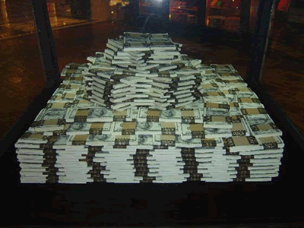
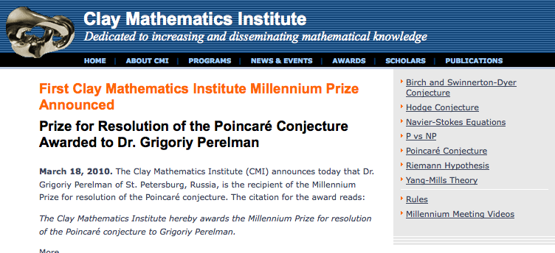
Poly time algo for longest path?

Slide 6
P vs NP question
P: problems that can be solved by poly time algorithms
Is P=NP?
NP: problems that have polynomial time verifiable witness to optimal solution
Alternate NP definition: Guess witness and verify!

Slide 7
Proving P ≠ NP
Pick any one problem in NP and show it cannot be solved in poly time
Pretty much all known proof techniques provably will not work

Slide 8
Proving P = NP
Will make cryptography collapse
Compute the encryption key!
Prove that all problems in NP can be solved by polynomial time algorithms
Solving any ONE problem in here in poly time will prove P=NP!
NP
NP-complete problems

Slide 9
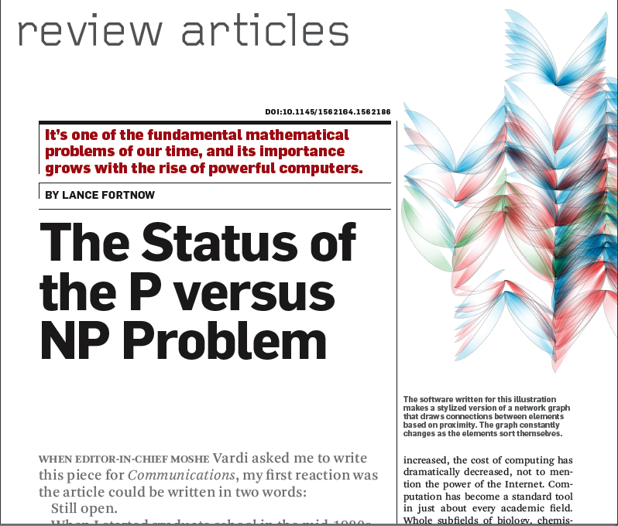
Nice survey on P vs. NP

Slide 10
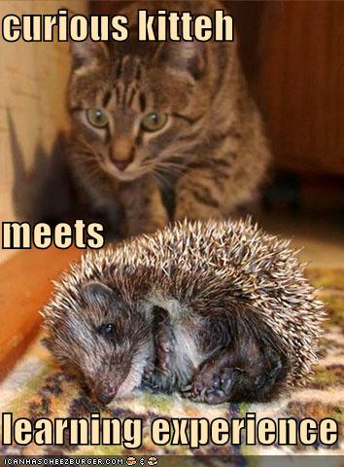
If you are curious for more
CSE431: Algorithms
CSE 396: Theory of Computation

Slide 11
What can I do with algorithms?

Slide 12
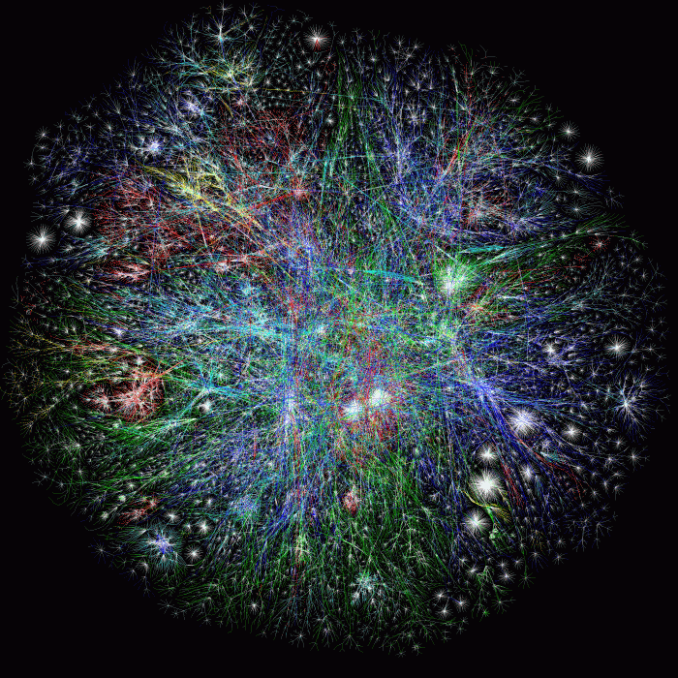
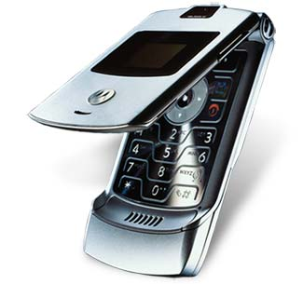
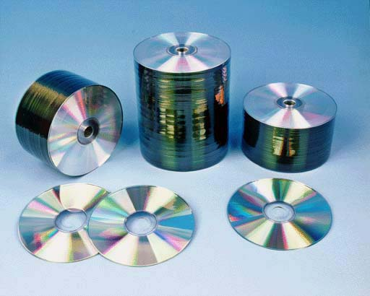
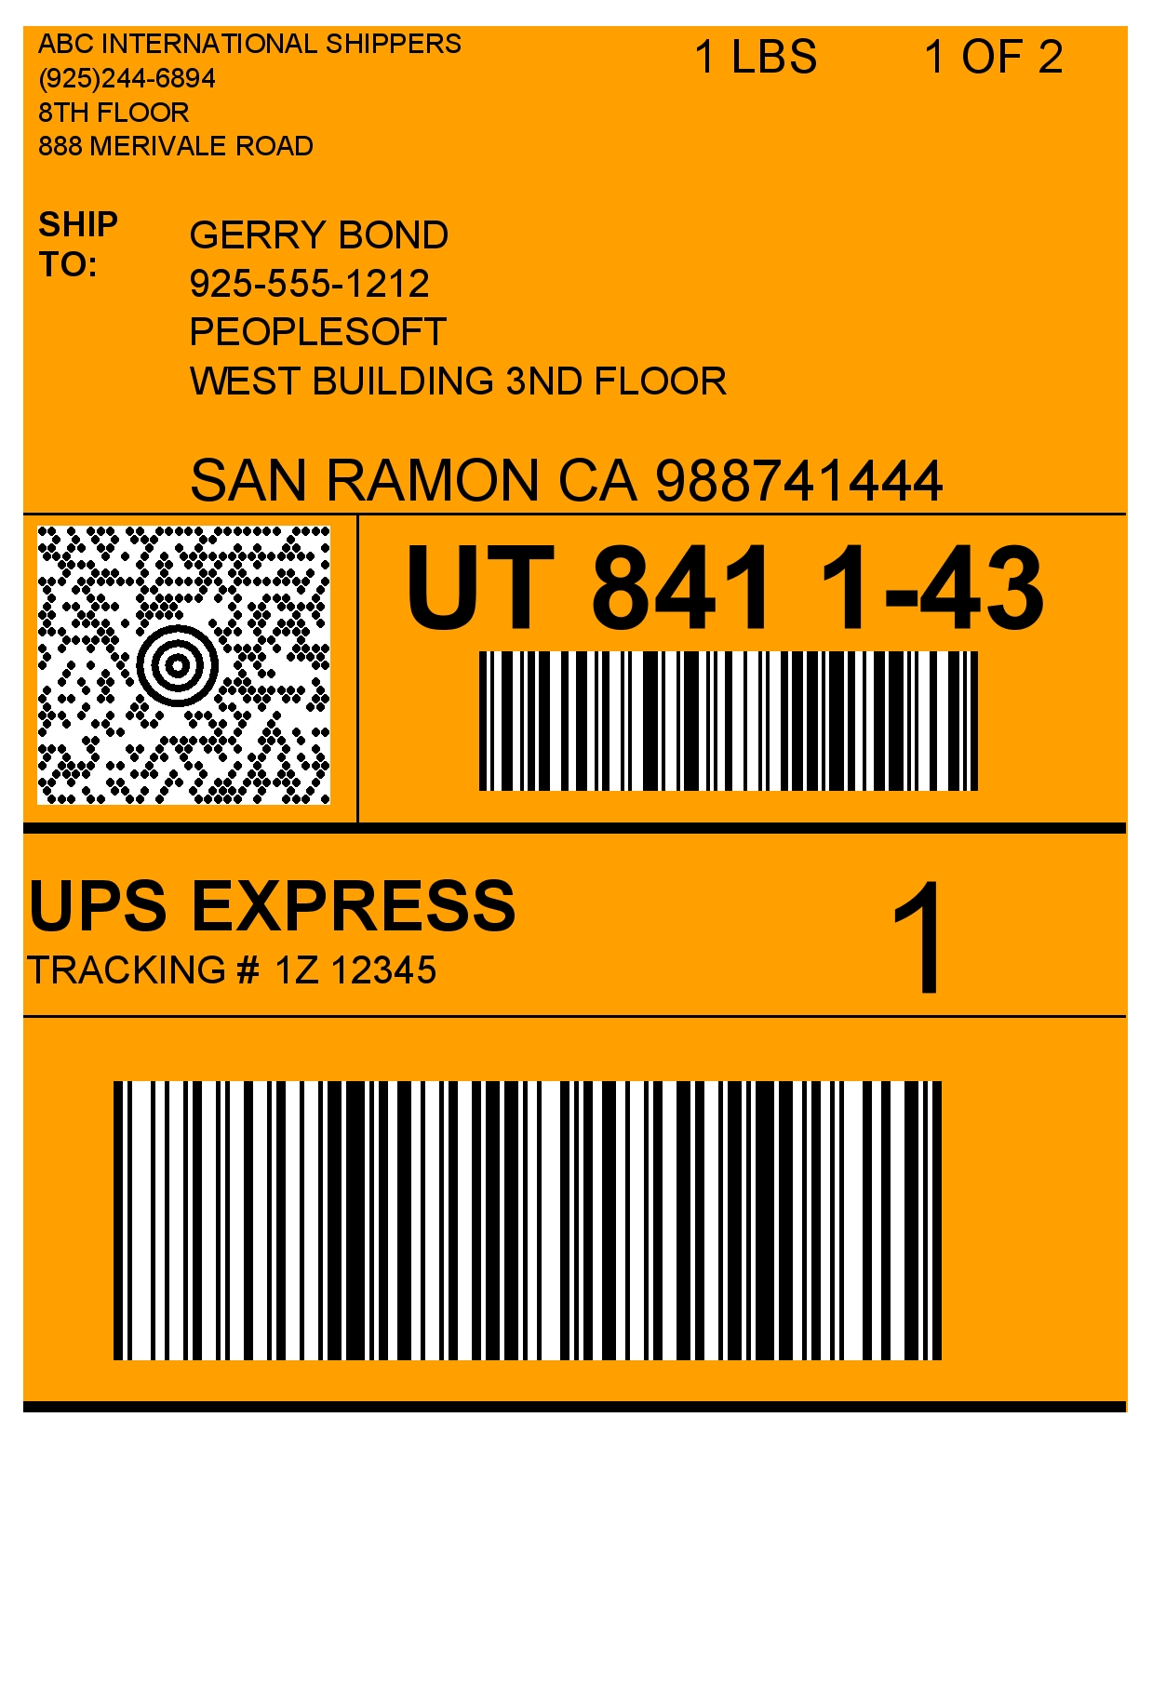
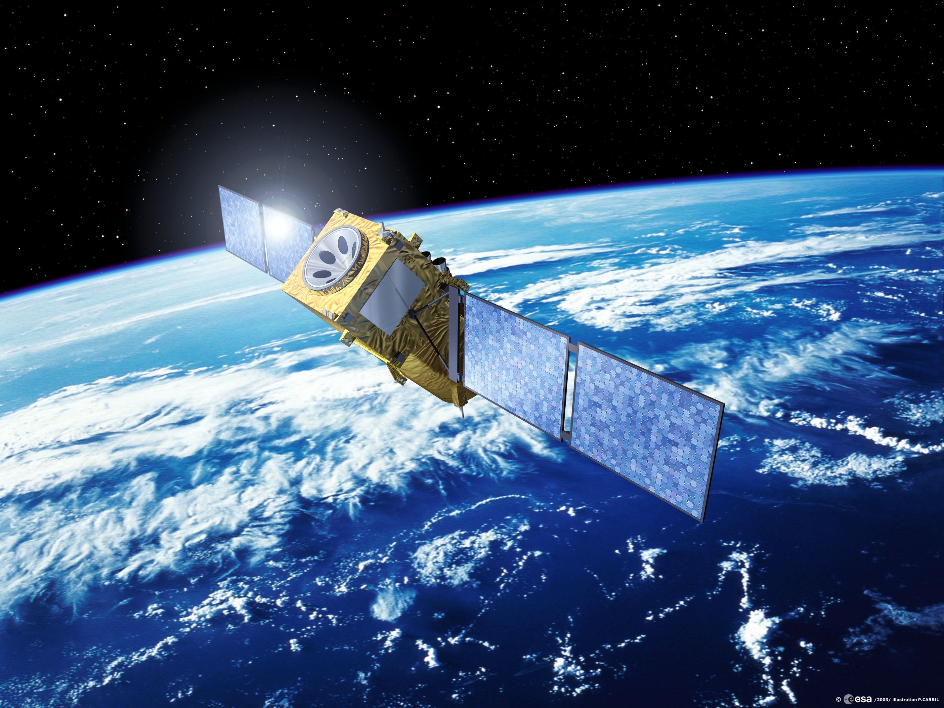
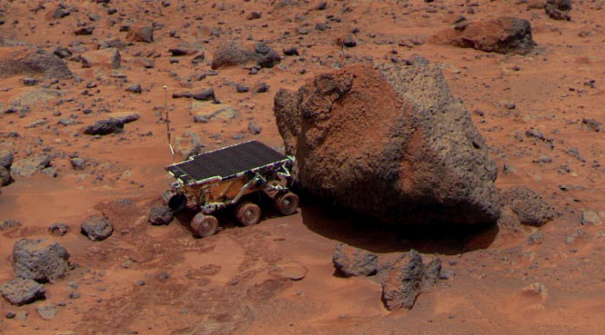
Coding Theory

Slide 13


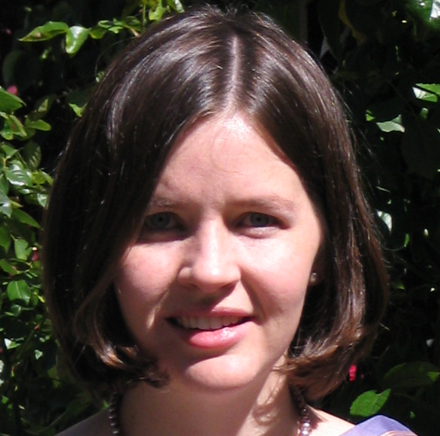
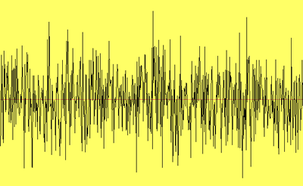
Communicating with my 3 year old
C(x)
x
y = C(x)+error
“Code” C
“Akash English”
C(x) is a “codeword”
x
Give up
Notes:
Did not get pirate is noise source. Mention not crypto but error correction

Slide 14
The setup
C(x)
x
y = C(x)+error
Mapping C
Error-correcting code or just code
Encoding: x → C(x)
Decoding: y → x
C(x) is a codeword
x
Give up
Notes:
Did not get pirate is noise source. Mention not crypto but error correction

Slide 15
Different Channels and Codes
Internet
Checksum used in multiple layers of TCP/IP stack
Cell phones
Satellite broadcast
TV
Deep space telecommunications
Mars Rover
Notes:
Mention what the picture of the internet depicts (IP connectivty)

Slide 16
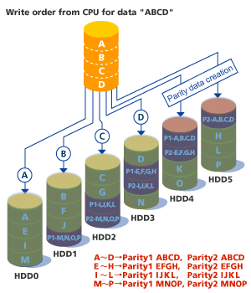
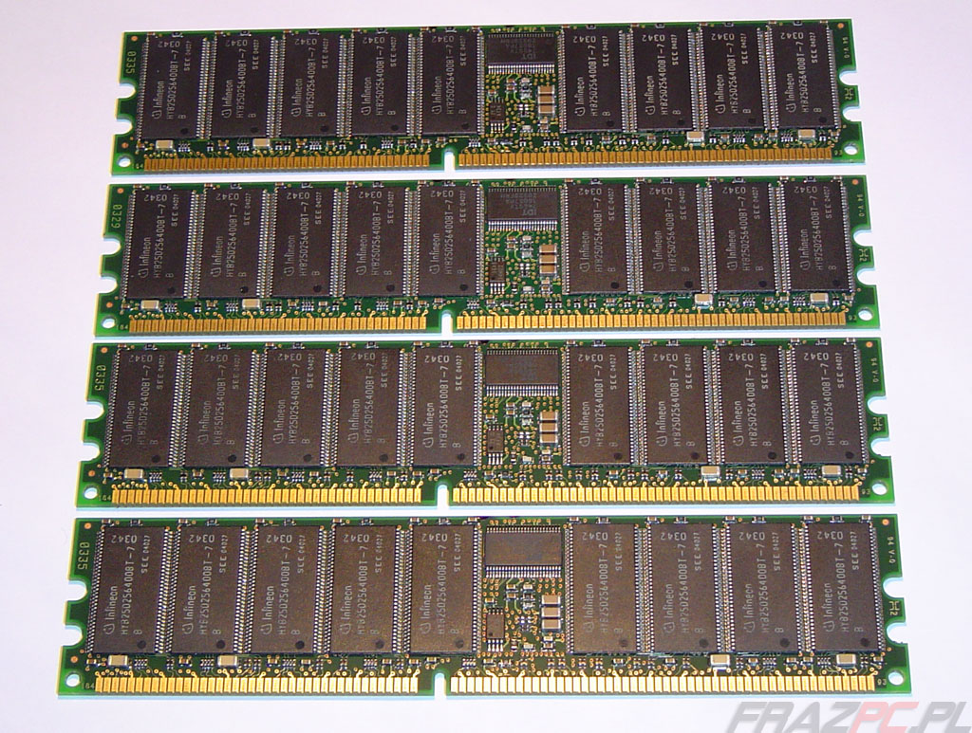
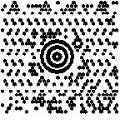
“Unusual” Channels
Data Storage
CDs and DVDs
RAID
ECC memory
Paper bar codes
UPS (MaxiCode)
Codes are all around us
Notes:
Do not spend much time on this slide. Maybe only talk about cd example in detail

Slide 17
Redundancy vs. Error-correction
Repetition code: Repeat every bit say 100 times
Good error correcting properties
Too much redundancy
Parity code: Add a parity bit
Minimum amount of redundancy
Bad error correcting properties
Two errors go completely undetected
Neither of these codes are satisfactory
1 1 1 0 0
1
1 0 0 0 0
1
Notes:
Give an example of the parity code – two close by codewords

Slide 18
Two main challenges in coding theory
Problem with parity example
Messages mapped to codewords which do not differ in many places
Need to pick a lot of codewords that differ a lot from each other
Efficient decoding
Naive algorithm: check received word with all codewords
Notes:
Need to explain the spheres more.Next idea after repetitions and parity

Slide 19
The fundamental tradeoff
Correct as many errors as possible with as little redundancy as possible
Can one achieve the “optimal” tradeoff with
efficient encoding and decoding ?
Notes:
Mention that encoding is generally easy

Slide 20
Interested in more?
CSE 545

Slide 21


Group Testing Overview
Test soldier for a disease
WWII example: syphillis

Slide 22
Group Testing Overview
Can pool blood samples and check if at least one soldier has the disease
Test an army for a disease
WWII example: syphillis
What if only one soldier has the disease?

Slide 23
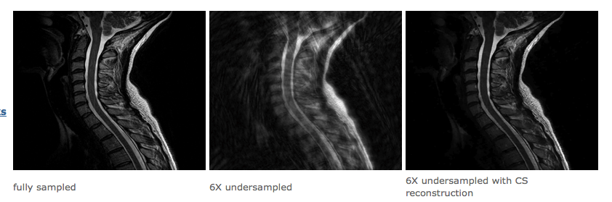
Compressed Sensing
http://www-stat.stanford.edu/~candes/stats330/index.shtml

Slide 24
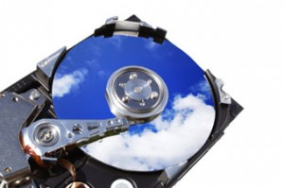
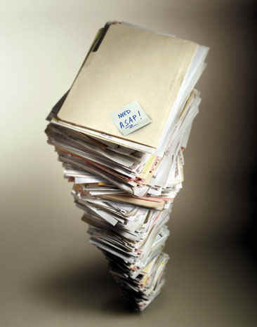
Moving your data to the cloud
http://myhosting.com/blog/2011/06/cloud-storage-vps-vps-remote-fill-storage/
http://1sdiresource.com/pile.jpg

Slide 25

What if the cloud was bad?
http://area.autodesk.com/userdata/forum/h/harry_potter_clouds_scene.jpg

Slide 26
It all comes back to the same thing
Coding
Theory
LIST
DECODING
Complexity
Theory

Slide 27
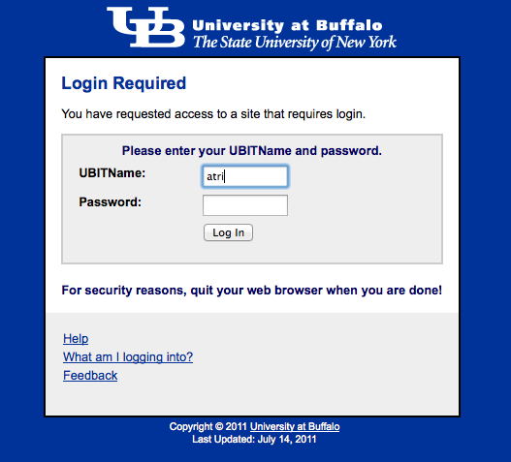
Passwords
Fast matching
Secure
“Cancelable”
One can forget them!

Slide 28
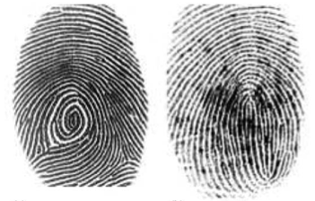
Fingerprints
Fast matching
?
Secure
?
“Cancelable”
Cannot forget them!

Slide 29

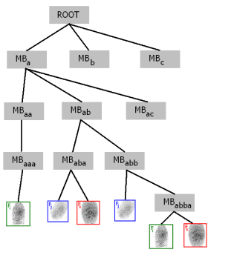
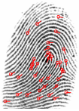
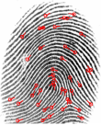


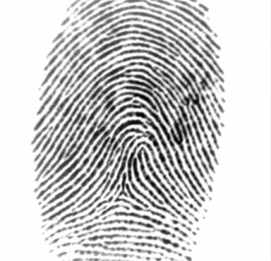

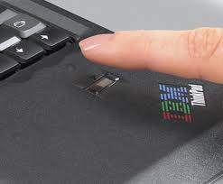
Fingerprints as Passwords
Or making “Forgot password” links obsolete
?
Only Fast
Fast & Secure
Only Secure

Slide 30
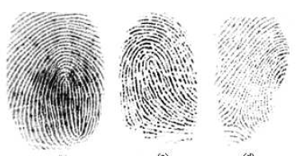
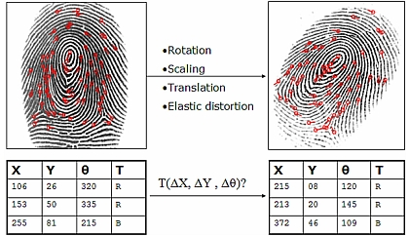
Fingerprint Matching
Fingerprint readings are inconsistent
Matching Algorithms exist
even in practice…

Slide 31

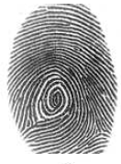

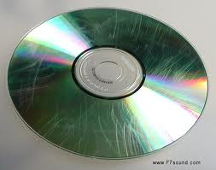
Security for fingerprints?
Stored fingerprints can be stolen
Easy
Hard
Main idea: obfuscate the fingerprint!
Use error correcting codes

